Slide 1
Project on:
Typing Master Software
Group Members:
Aniket Vasant Warade
Subodh Vikas Deshmukh
Sandesh Narayan Bhoir
Piyesh Kamalakar Patil
Guided by:
Miss. Namrata Raut

Slide 2
Agenda
Introduction.
Use Case Diagram.
DFD
Level 0th DFD.
Level 1St DFD.
Design of Software.
Requirements.
Advantages.
Conclusion.
References.

Slide 3
Introduction
Typing Master Software program is designed to enhance person’s ability in terms of speed and accuracy.
It is also used to teach the correct positioning of fingers on the keyboard for better posture and ease of typing.
It demonstrates how to position the hands over the keys and how to type quickly to improve your speed.
Typing Master Software will increase both physical and mental capabilities to stay typing for a long period of time.

Slide 4
Use Case Diagram
Enters User Name
Takes a Typing Test
Plays a Word Game
User
Typing Master Software
Result of Typing Test

Slide 5
Level 0th DFD for Typing Master Software
Typing Master Software
User uses
User Enters
User
User Name

Slide 6
Level 1st DFD for Typing Master Software
User Name
User Enters
User
Takes
Typing Test
Typing Master Software
User uses
User
User
Plays
Word Games
Report
Typing Test Result

Slide 7
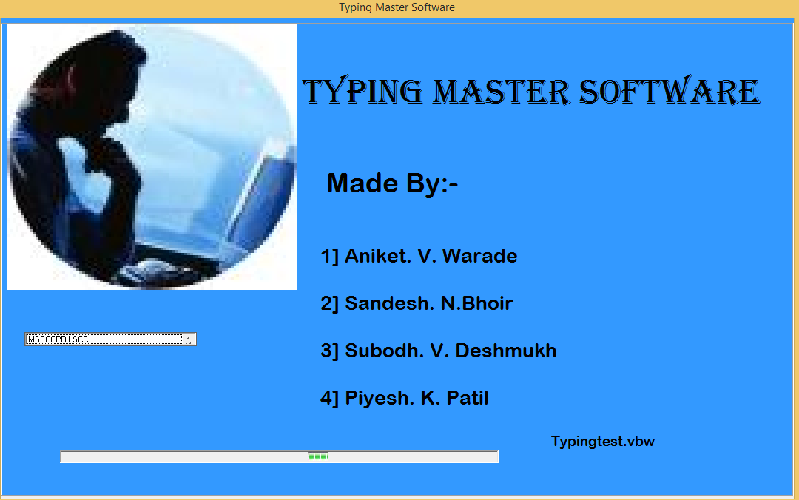
Load Form

Slide 8
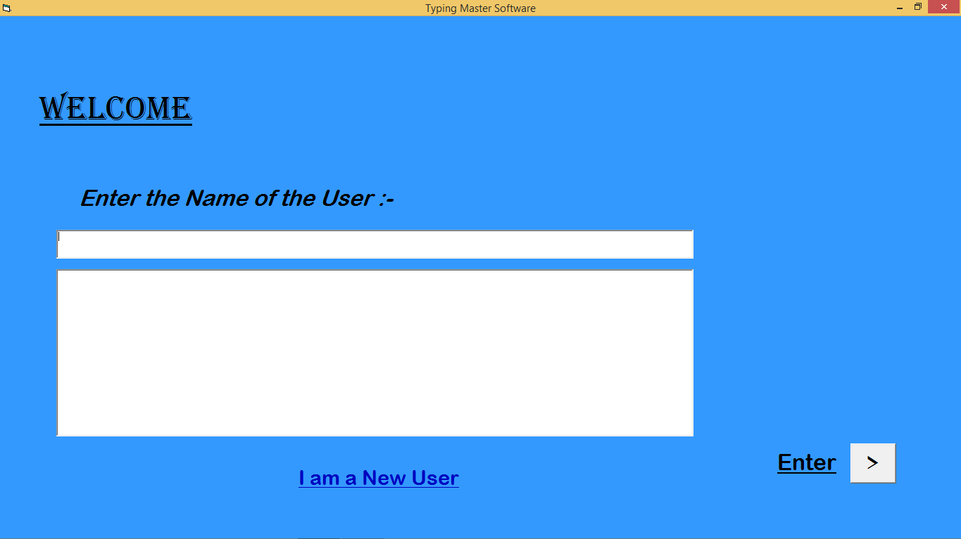
User Name Form

Slide 9
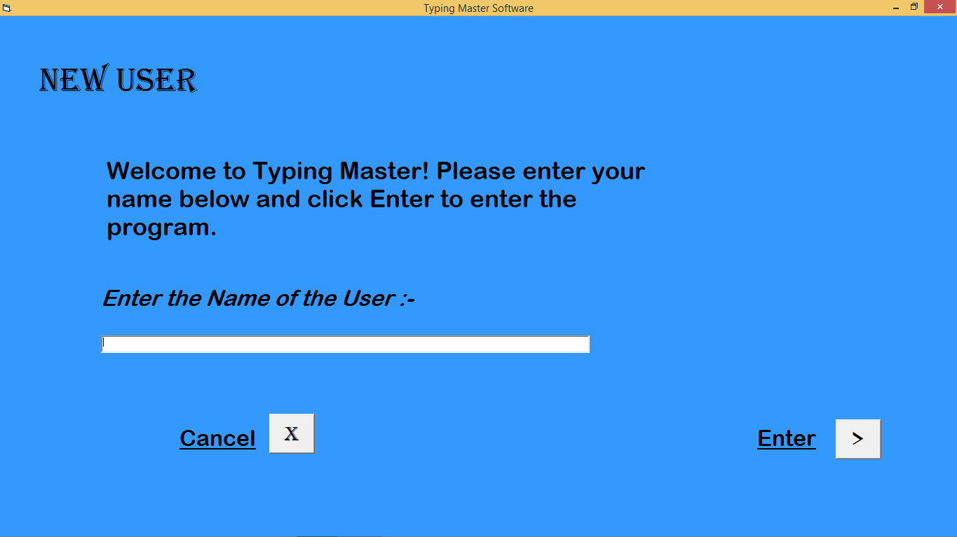
New User Name Form

Slide 10
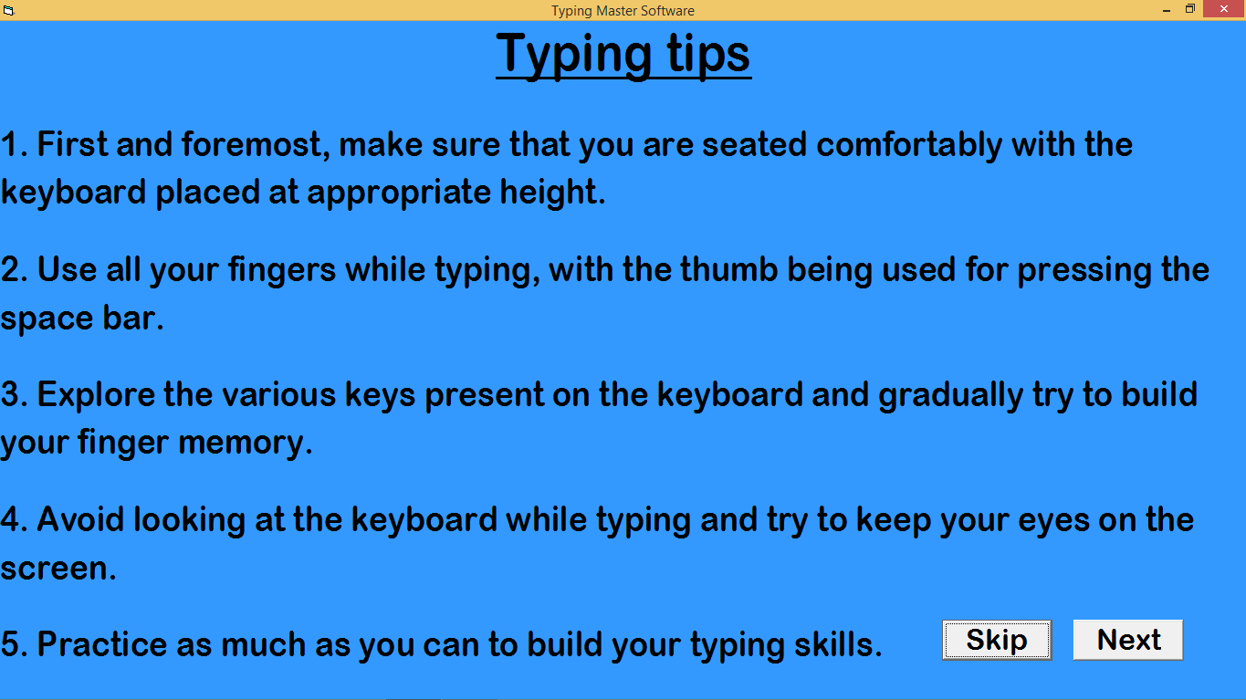
Instructions Form

Slide 11
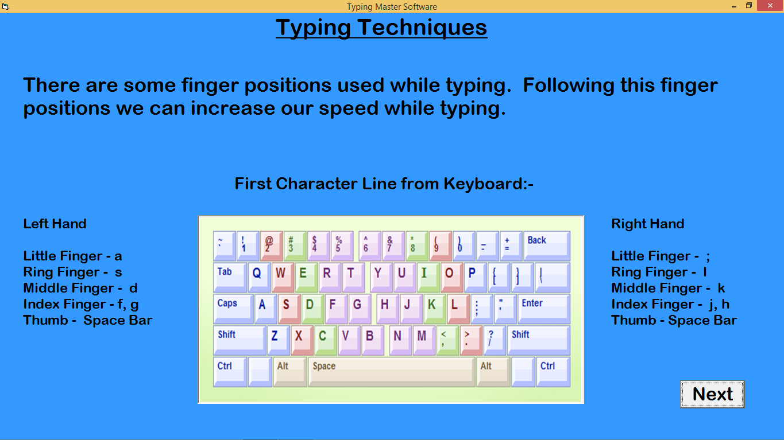
Instructions Form

Slide 12
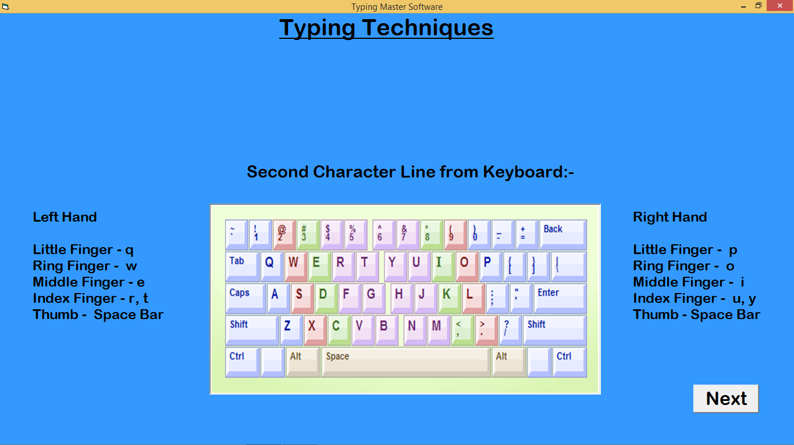
Instructions Form

Slide 13
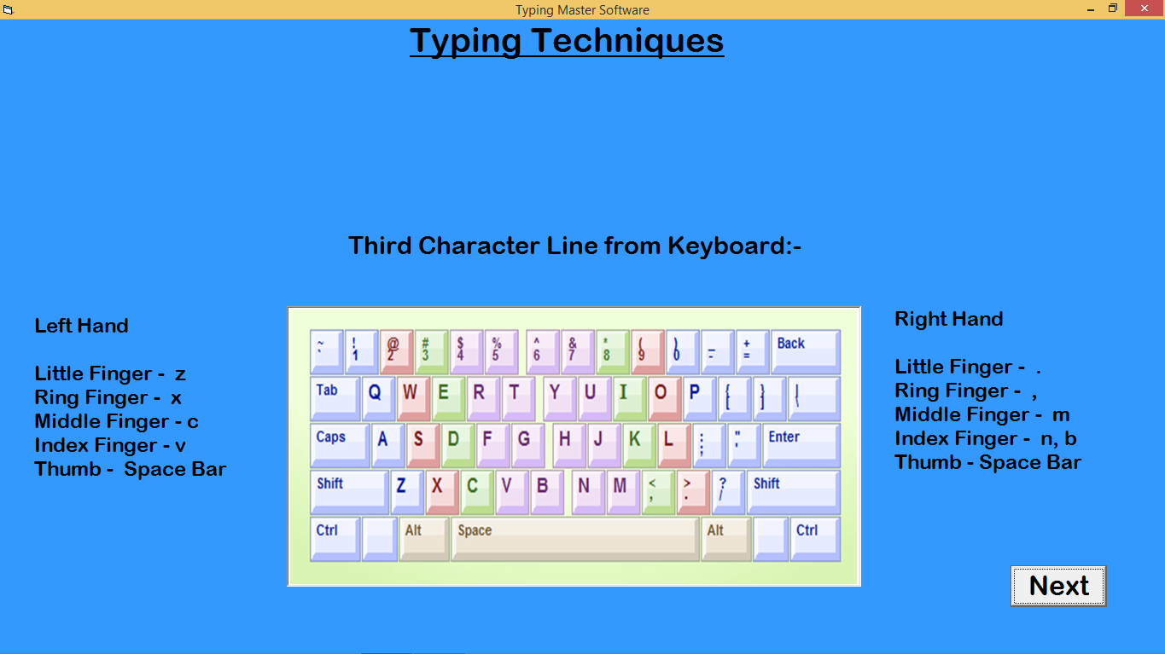
Instructions Form

Slide 14
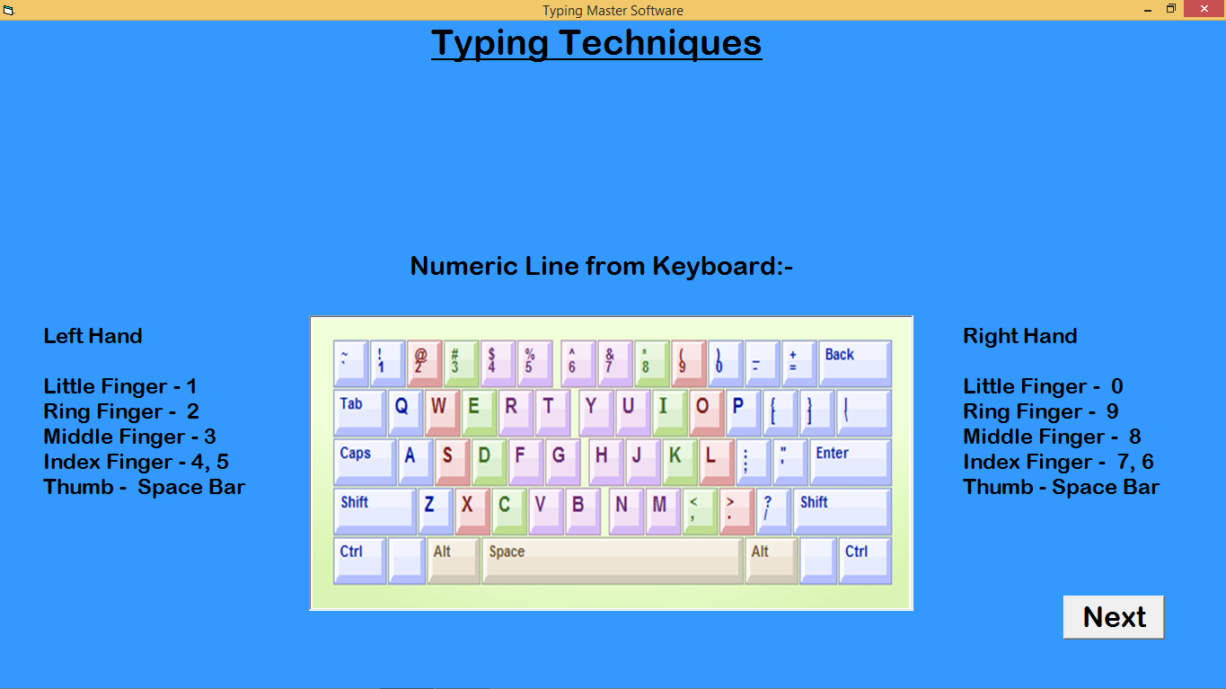
Instructions Form

Slide 15
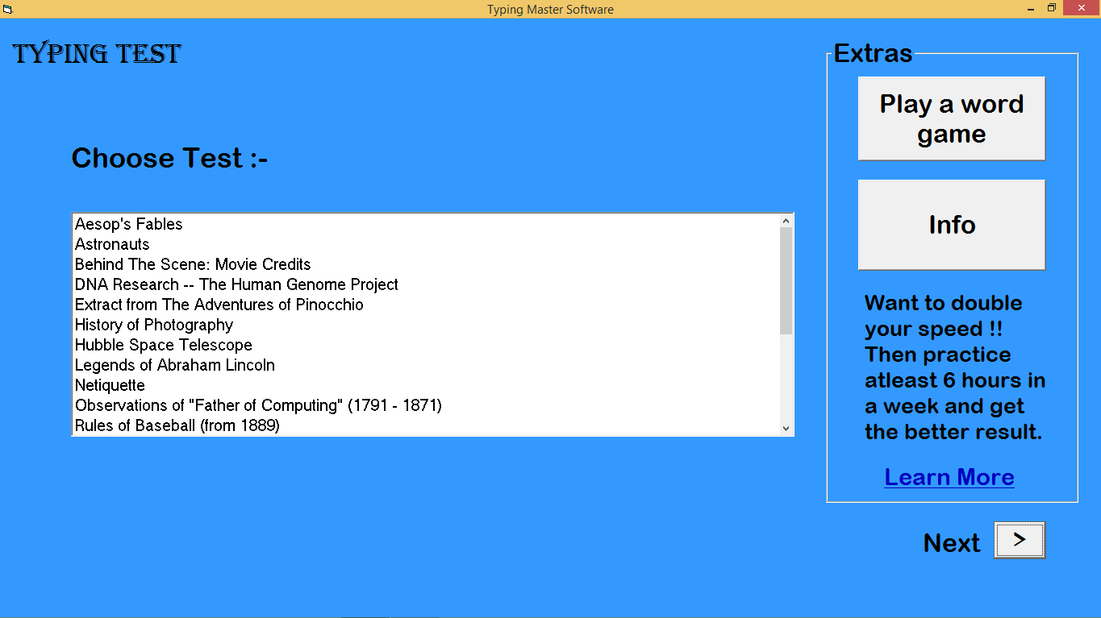
Select a Typing Test Form

Slide 16
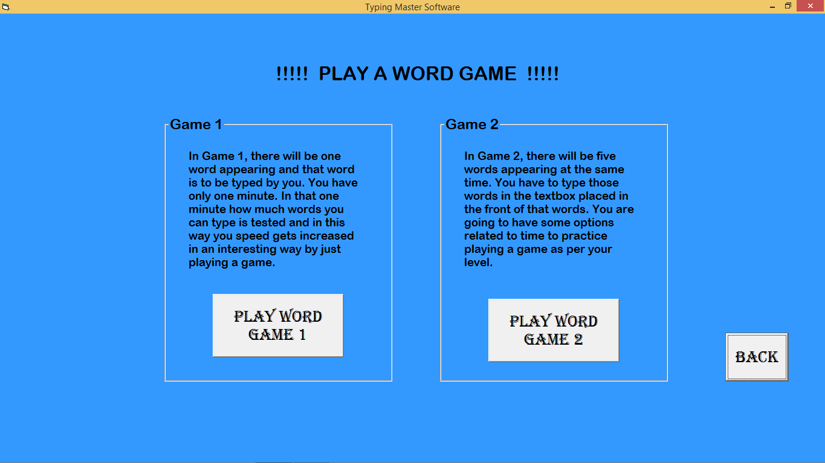
Select a Word Game Form

Slide 17
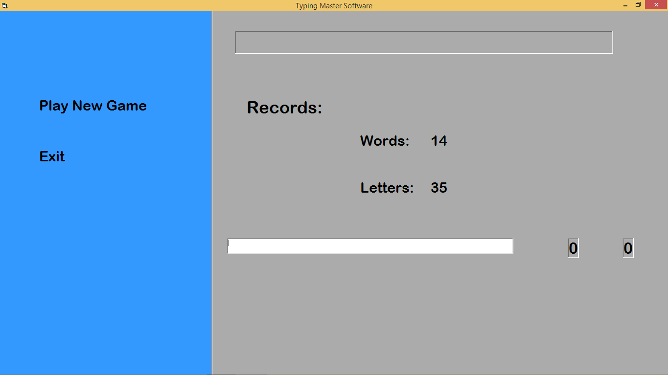
Word Game 1 Form

Slide 18
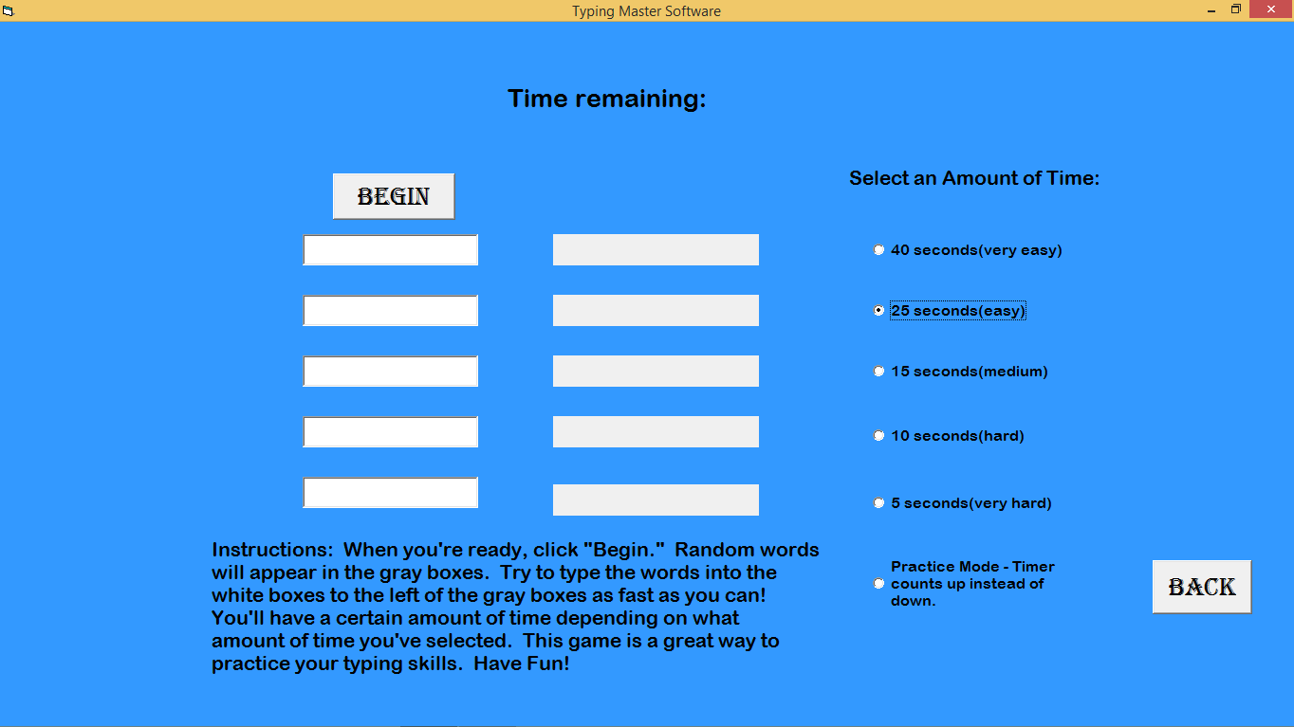
Word Game 2 Form

Slide 19
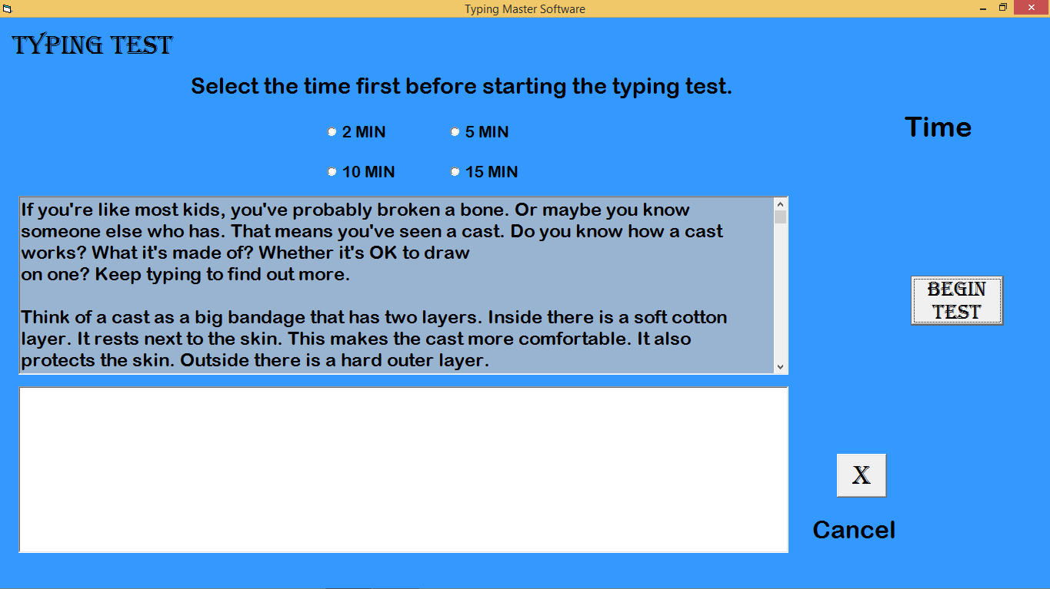
Typing Test Form

Slide 20
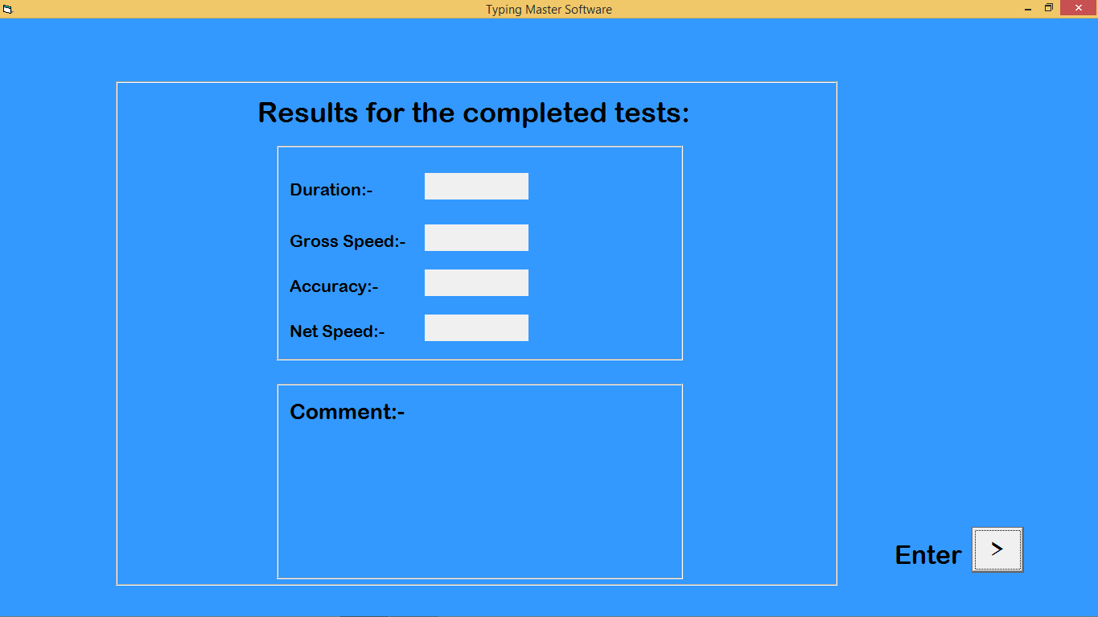
Result Display Form

Slide 21
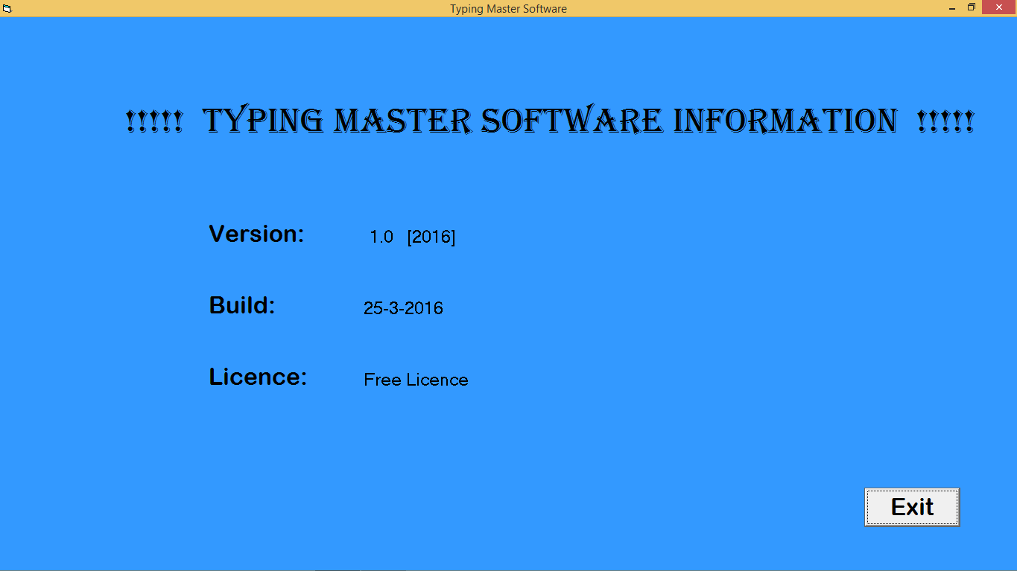
Software Information Form

Slide 22
Requirements
Hardware Requirements:-
Processor:- Pentium 300 MHZ or faster.
Ram:- 100 MB.
Hard Disk:- 500 MB.
High Color Display ( over 256-colours ) and 800 x 600.
Software Requirements:-
Operating System:- Windows 7, Windows 8, Windows 10.
Languages used:- Visual Basics 6.0, HTML.
Database Stored in:- MS Access.

Slide 23
Advantages
Increases Speed.
Increases Accuracy.
Builds Confidence while typing.
Creates interest in typing.
No need to join any typing course.

Slide 24
Conclusion
Typing Master Software helps you in increasing your speed and accuracy.
We have included two word games to make typing interesting.
So, Typing Master Software is a fun to increase your speed instantly.

Slide 25
References
Books Referred:-
Visual Basics 6.0: The Complete Reference.
Website Referred:-
www.typingmaster.com/typing.htm

Slide 26
Thank you

